Slide 1

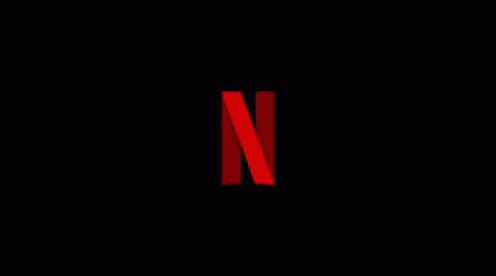

Slide 2




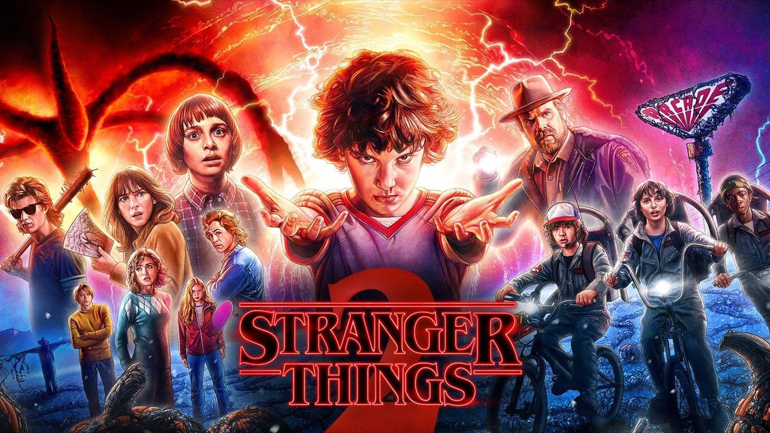




NETFLIX MOVIE RECOMMENDATION SYSTEM
GROUP 7
SONAL CHATURVEDI | DEBJEET DAM | AVINASH KUMAR MISHRA| ANTARA SAHA

Slide 3
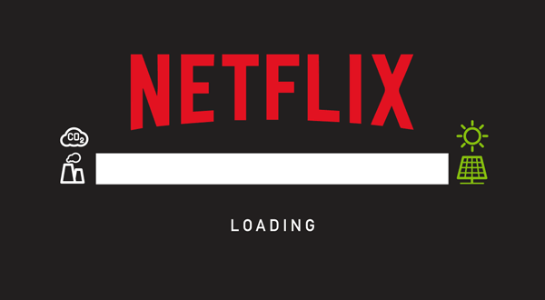
MOTIVATION
Wherever we want to watch latest movies or series mostly we go for popular streaming networks such as Netflix, Amazon Prime and so on. And there is such a wide variety of shows and movies available that everyone can find something they like. But when there are more than 14000 options, how would we choose one that we might like? In that case, Machine Learning can be a big help. There are many models of machine learning used by these streaming networks, among which the most popular is their content recommendations system that helps us decide what we might like to watch.
Notes:
Breaking Bad, Better Call Saul

Slide 4
GOAL
Creating a recommendations system based on an algorithm that considers your past choices in movies, matching with previous users with a similar taste.
Thus, bypassing thousands of Netflix titles and recommending something according to the users taste.
Also, a scope for storytelling through wide range of different graphs and visuals along with our content-based recommendation system.

Slide 5




Overview
Exploratory Analysis of content on Netflix using various Visualization libraries and plots such as: Seaborn, WordCloud, Lollipop plot, and so on.
2. Data Pre-processing – Feature Scaling, creating new features.
3. Recommendation System ( Content Based: Term Frequency-Inverse Document Frequency (TF-IDF))

Slide 6


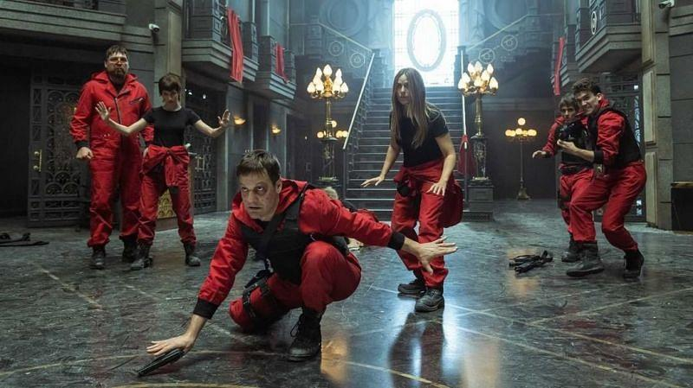
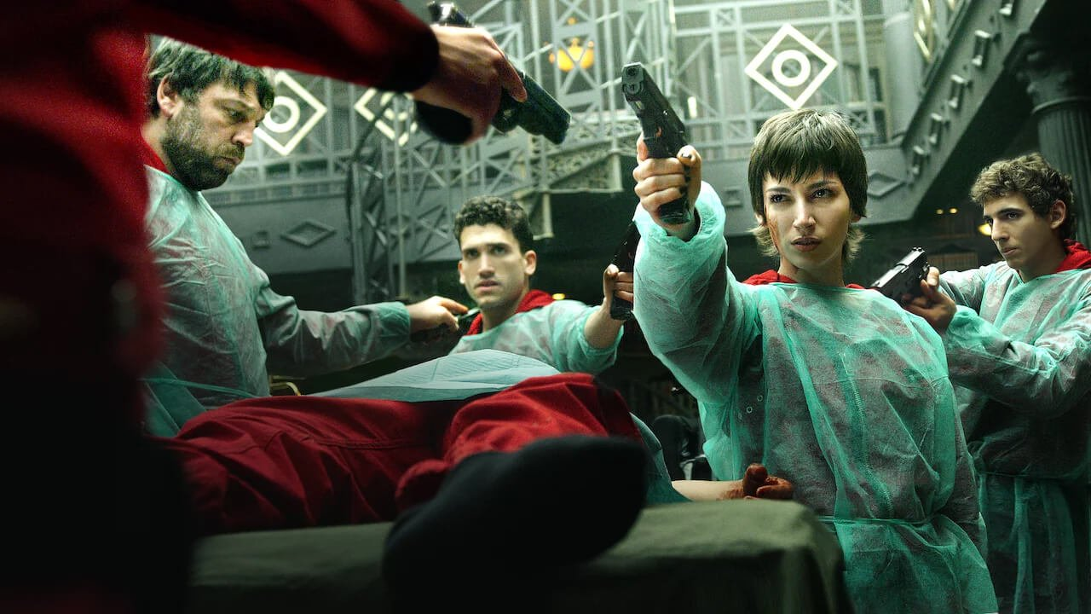
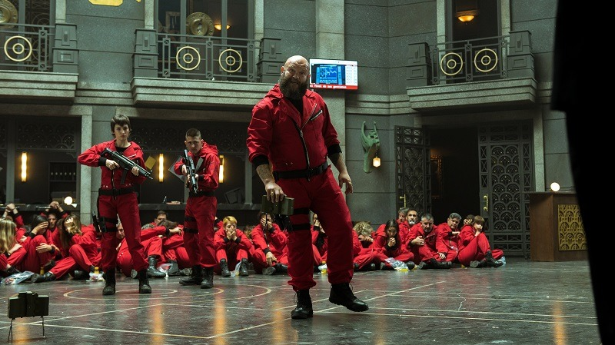
16+
CC
Data
2020
|
English
Contains 100,000+ Observations
20+ attributes (both numeric and categorical)
We have used a dataset containing 8807 unique values of show titles including their cast, director, genre, rating, duration, etc.
We have used a dataset that contains the Netflix shows and movie data along with their IMDB ratings.
Season 1
Netflix Data
IMDB Ratings
Data Available on Kaggle.
Data Available on Kaggle.
50 min
54 min
IMDB User
IMDB Movies
60 min
48 min
Data Available on Kaggle.
Data Available on Kaggle.
Notes:
THERE ARE SEVERAL DATASETS AVAI to bld recc syste. We are going to use dataset which contains Netflix shows and movie data, along with their ratings in IMDB. Kaggle - Netflix Movies & TV Shows

Slide 7
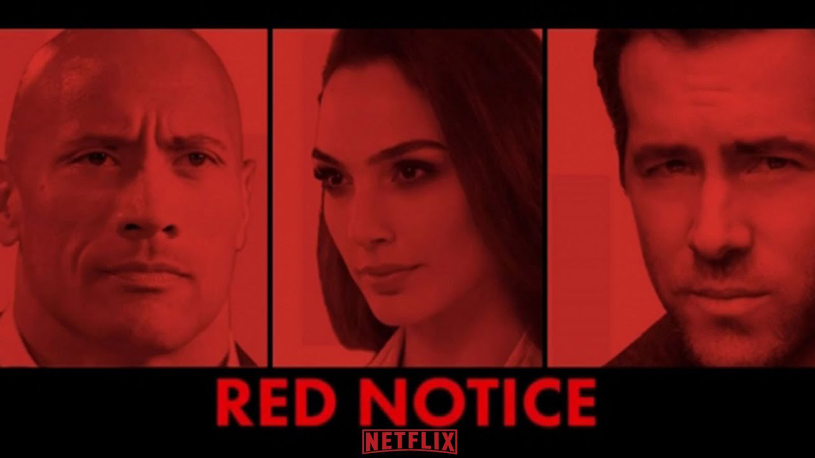



RELEASE CALENDAR
If a producer wants to release some content, which month must he do so?
1
3
8
10
13
15
17
2
4
9
11
14
16
18
NOV 6 - ARCANE
NOV 12 – RED NOTICE
19
21
23
25
27
29
4
20
22
24
26
28
30
5
NOV 19 – COWBOY BEBOP
DEC 1 – LOST IN SPACE
6
8
10
12
21
23
25
7
9
11
13
22
24
26
DEC 17 - THE WITCHER
DEC 31 – COBRA KAI
Notes:
We can estimate this using…

Slide 8
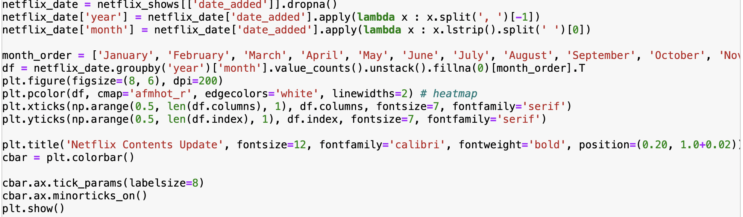
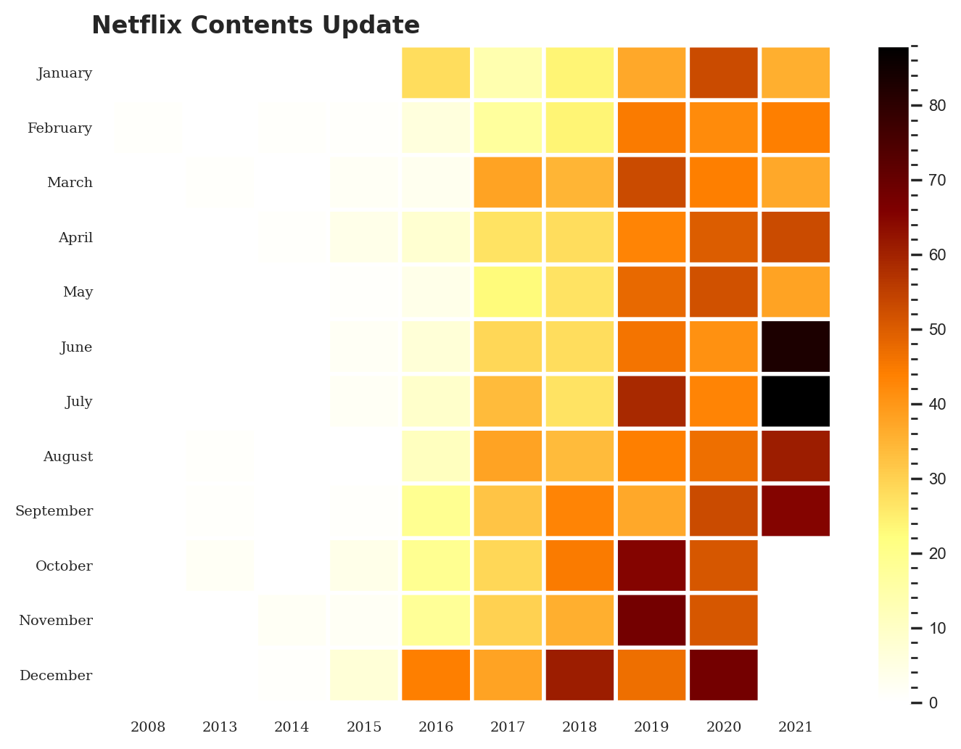
Notes:
…this Heatmap.

Slide 9
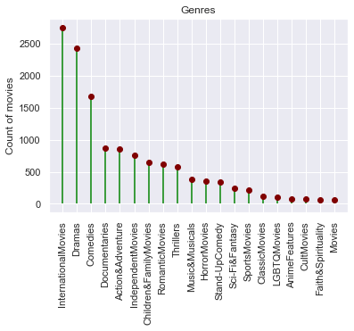
Lollipop plot of Genres vs their count on Netflix (Movies)
TOP GENRES
Drama, Comedy, Documentaries, Action
Upto more than 2500 shows for InterNational Movies

Slide 10

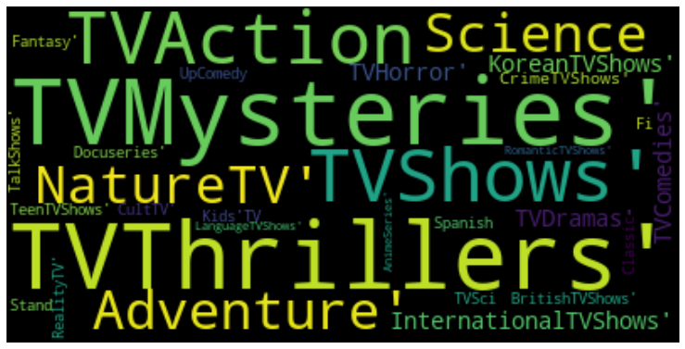
16+
CC
Word Cloud for Genres (TV Shows).
2020
|
English
Notes:
Created this plot using Word cloud library

Slide 11
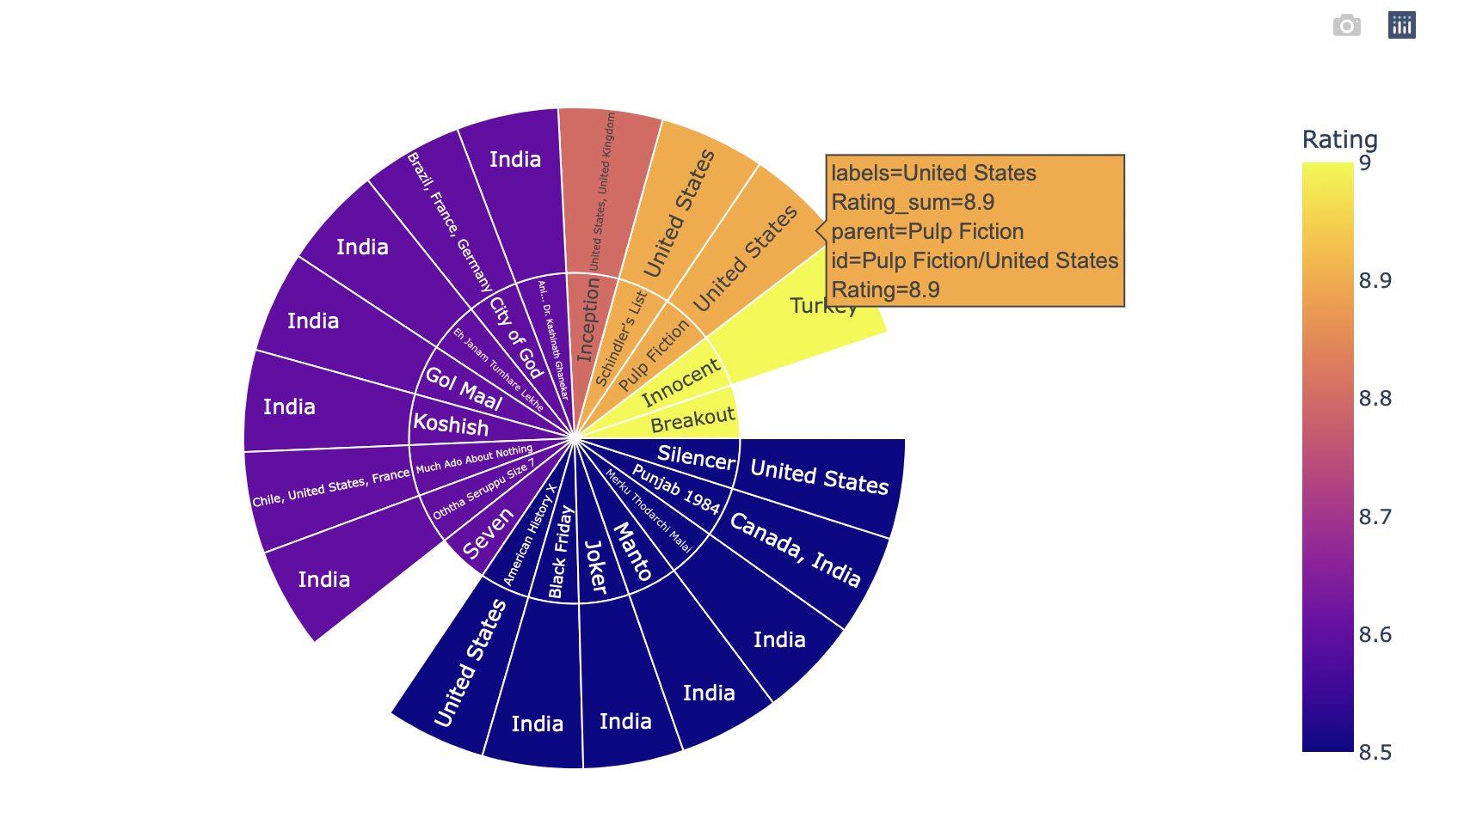
Top Rated Movies using “Plotly”
Country which Rated the most
TOP GENRES
India
Drama, Action, Sci-Fi, Fantasy
from 32 shows
Notes:
Dynamic chart representation of top rated movies across the world using Plotly express.

Slide 12
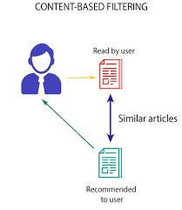
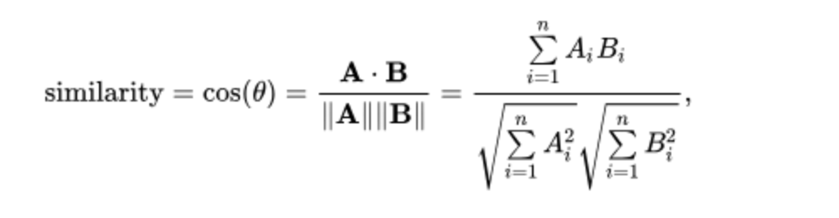
RECOMMENDATION SYSTEM (Content Based)
Term Frequency-Inverse Document Frequency
Frequency of a word occurring in a document, down-weighted by the number of documents in which it occurs.
Notes:
Antara to explain the logic behind the recc system

Slide 13
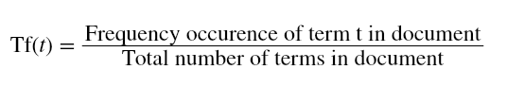
LOGIC USED
What are the concepts used in Content Based Recommenders?
Term Frequency-Inverse Document Frequency (TF-IDF)
TF-IDF is used in information retrieval for feature extraction purposes and it is a sub-area of natural language processing (NLP).
Term Frequency: Frequency of the word in the current document to the total number of words in the document. It signifies the occurrence of the word in a document and gives higher weight when the frequency is more, so it is divided by document length to normalize.

Slide 14
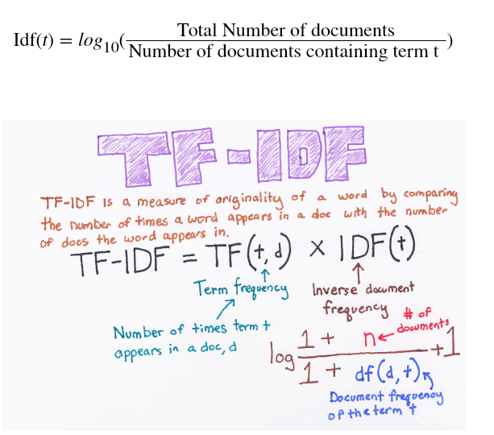
Inverse Document Frequency: Total number of documents to the frequency occurrence of documents containing the word. It signifies the rarity of the word — the less the word occurs in the document, the IDF increases. It helps in giving a higher score to rare terms in the documents.

Slide 15
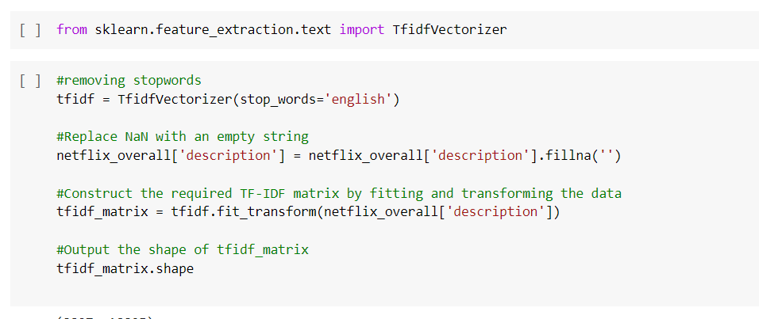
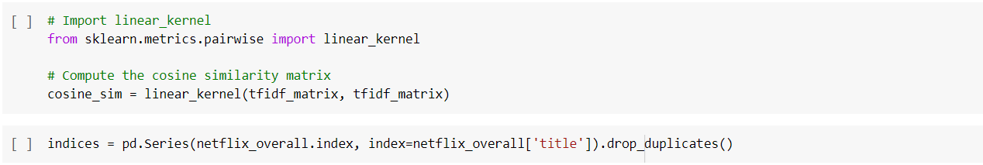

Slide 16
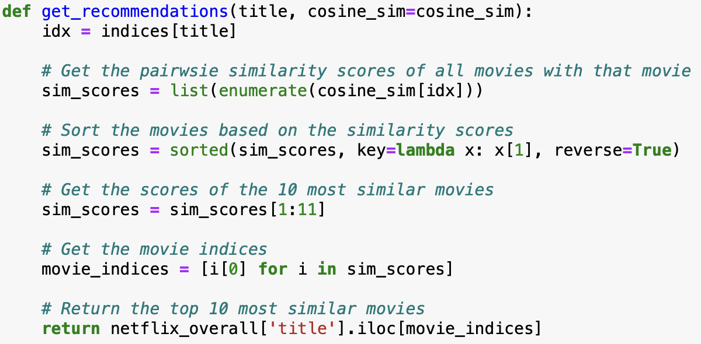
FUNCTION 1
Recommendations based solely on “Plot”.

Slide 17
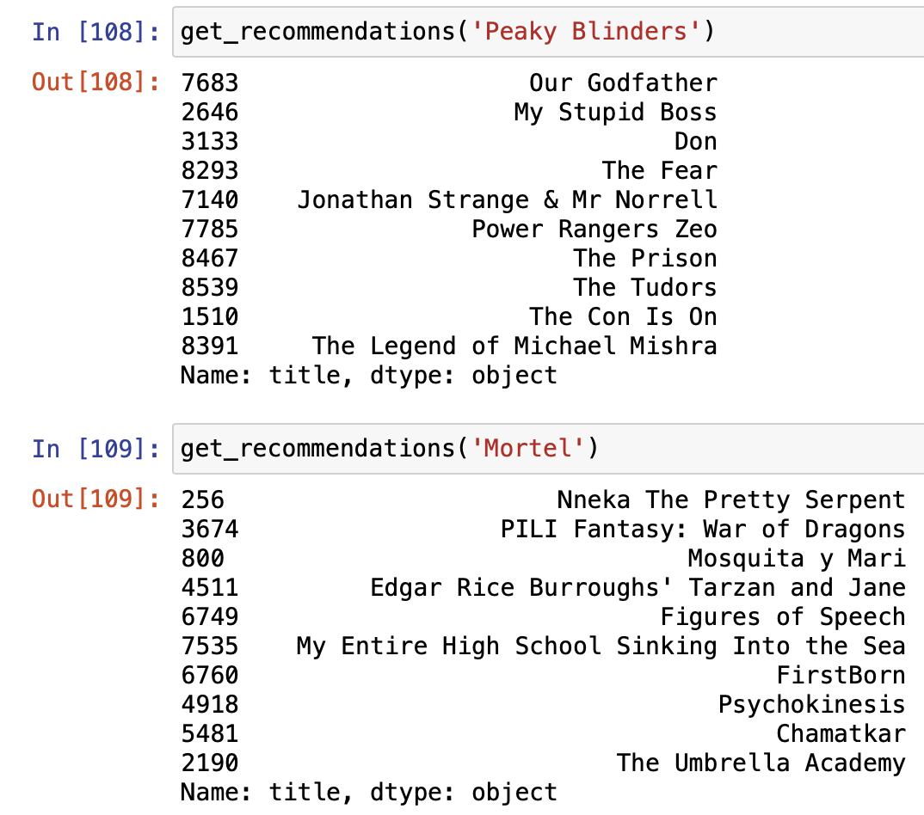
Results from Function 1
From the results, the model performs well, however is not very accurate.Hence, more metrics are added to the model to enhance the overall performance and accuracy.

Slide 18
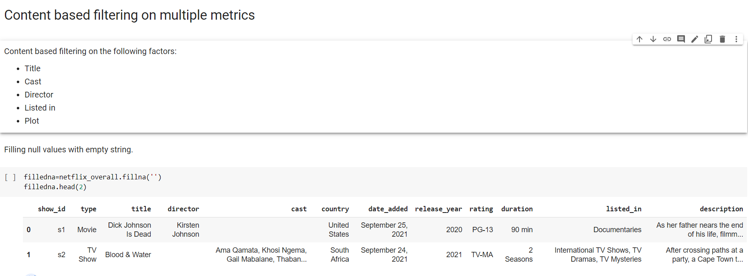
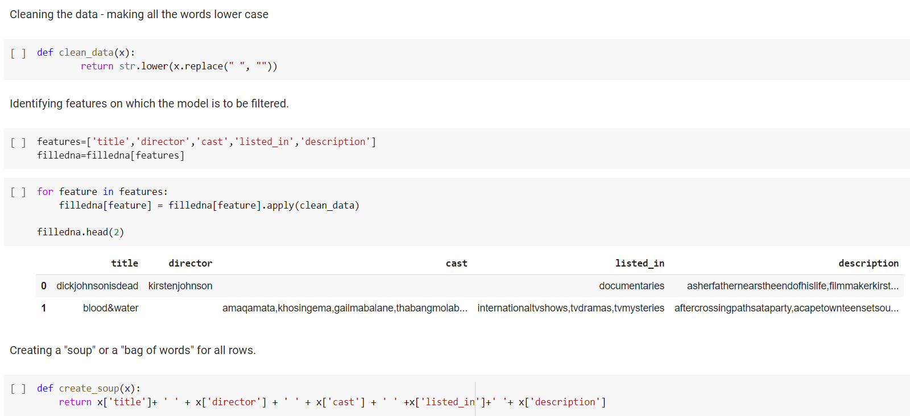

Slide 19
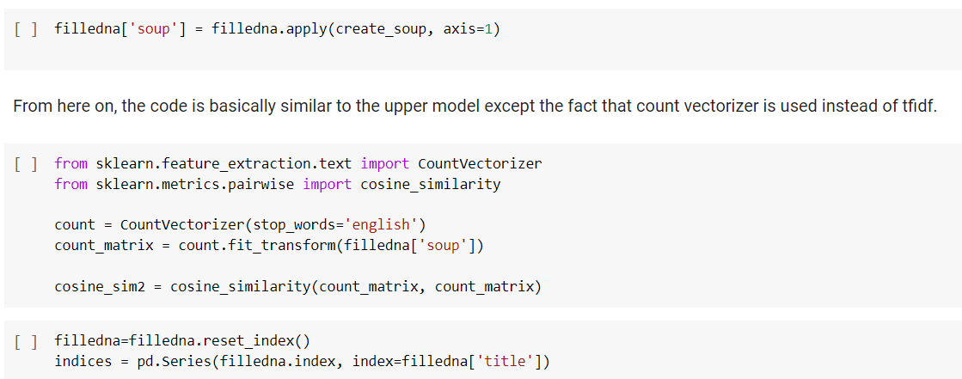

Slide 20
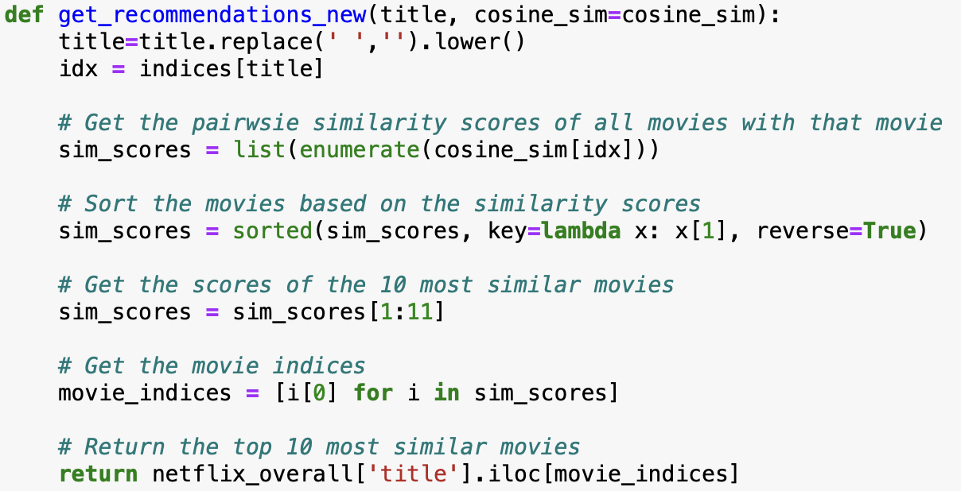
FUNCTION 2
Content based filtering on the following factors : Title, Cast, Director, Listed in, Plot

Slide 21
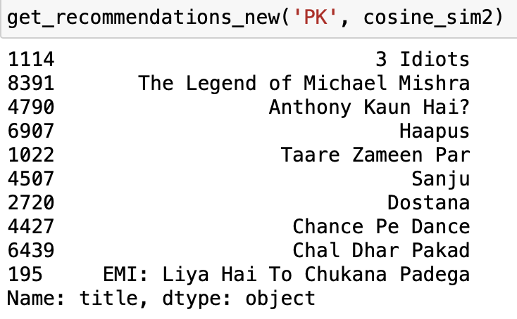
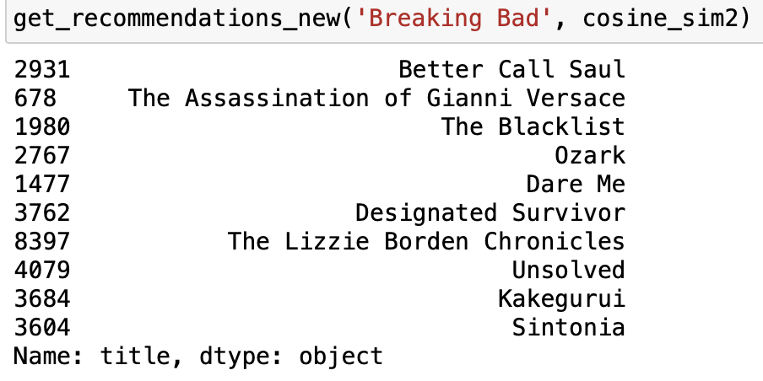
Results from Function 2
The current model looks good! The system recommends similar movies by filtering with similar genres, actors, directors.

Slide 22
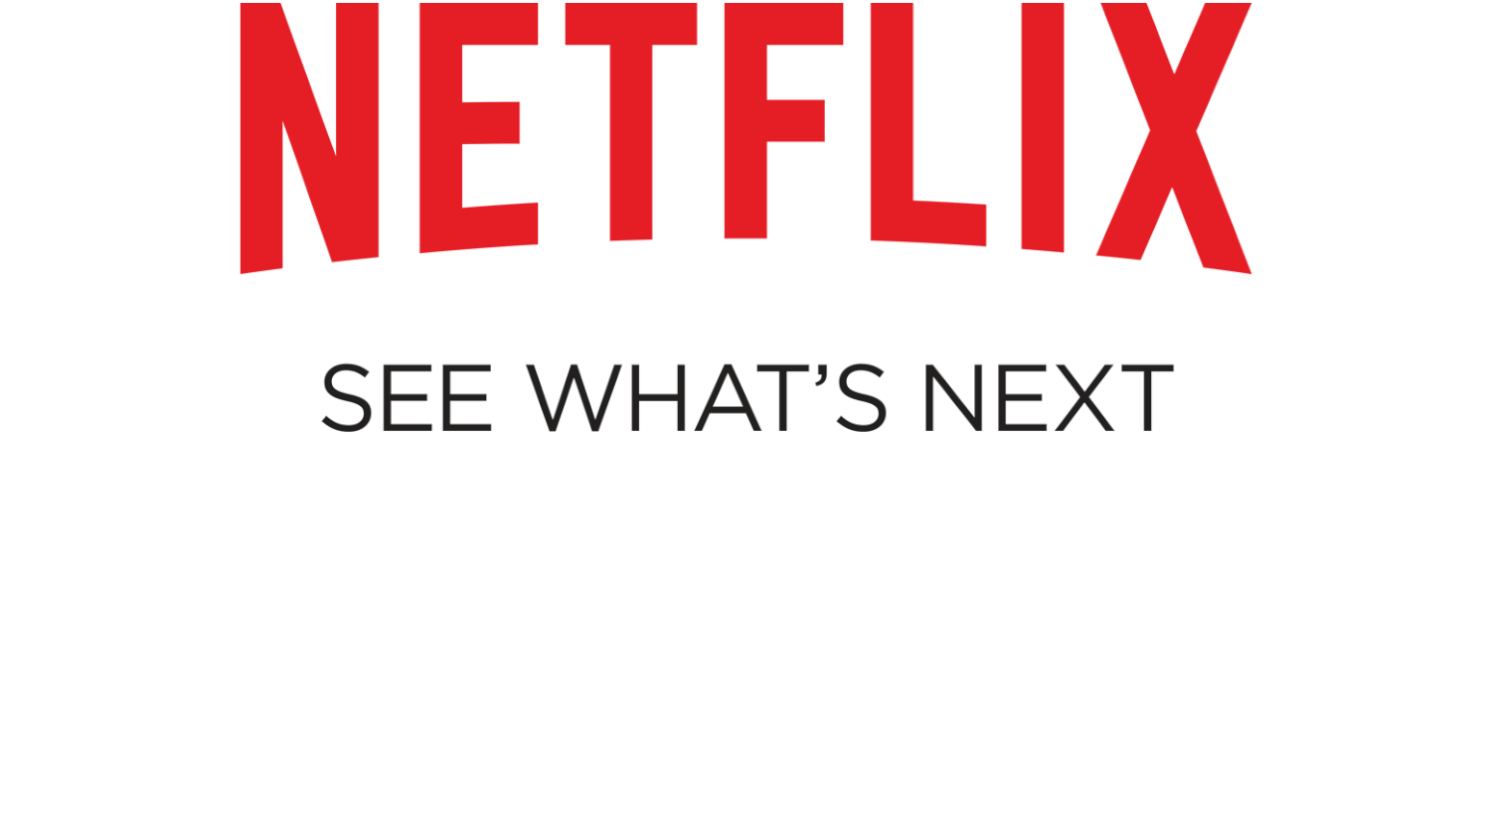
LIMITATIONS AND FUTURE SCOPE

Slide 23
LIMITATIONS
Limitations of Content Based Recommender Systems
Content based recommenders have their own limitations. They are not good at capturing inter-dependencies or complex behaviors. For example: I might have watched “Dunkirk” half way through, and didn’t like it, but this data will also be filled to the recommendation system and will might show me similar movies. This type of information cannot be captured by these recommenders.

Slide 24
FUTURE SCOPE
Netflix is an application that keeps growing bigger and faster with its popularity, shows, and content.
Thus giving us additional scope for creating recommendation system using different approaches which focuses on collecting and analyzing data on user behavior, activities, and preferences, to predict what a person will like, based on their similarity to other users.

Slide 25
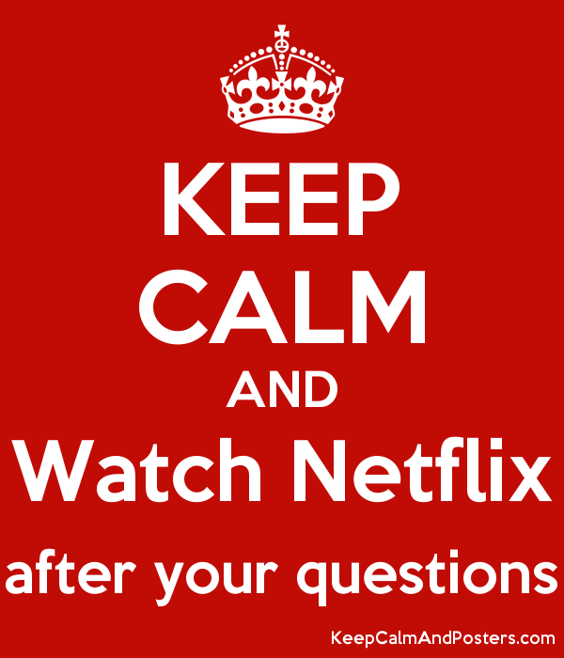
QUESTIONS?

Slide 26
